Slide 1


Unsupervised ML
California Housing Dataset

Slide 2

Overview
In this version of report, I used the unsupervised ML algorithms like Kmeans, DB scan and Hierarchal mean clustering, later on I used Isolation forest, LOF and Dbscan for the local and global outliers detection

Slide 3
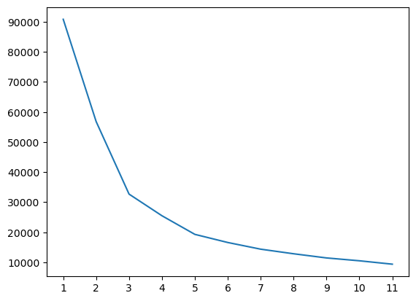
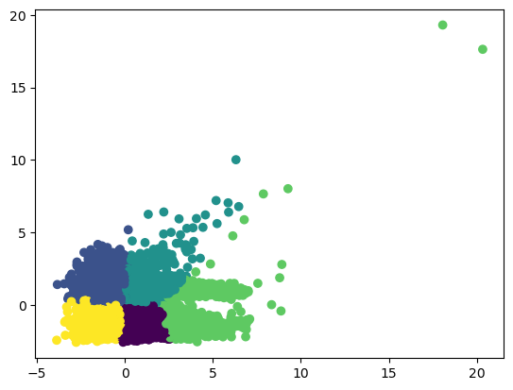
Kmeans Clustering
WCSS score then K=5
silhouette_score : 0.43880269602757505

Slide 4
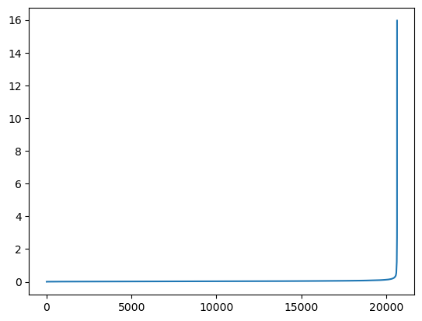
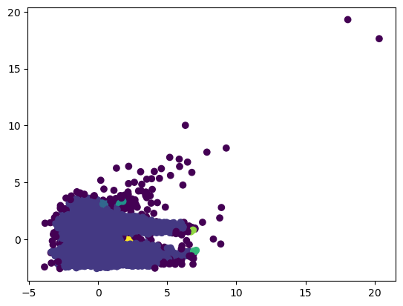
DB scan clustering
eps = 0.2, based on graph
silhouette_score : -0.0725706739092499

Slide 5
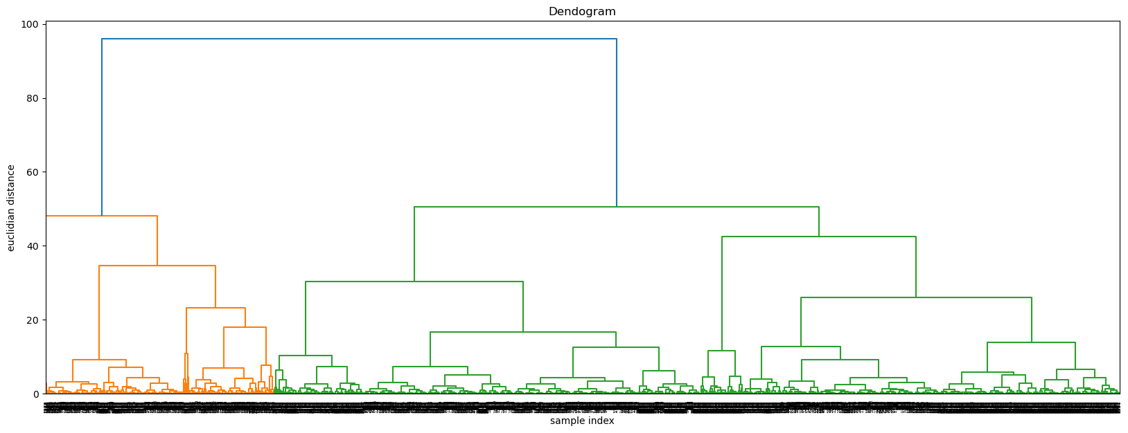
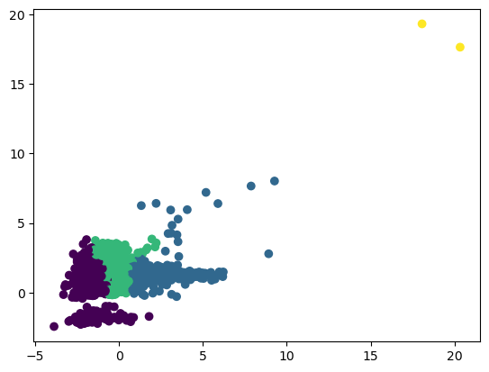
HM clustering
Dendogram then n = 4
silhouette_score : 0.3184251143059567

Slide 6
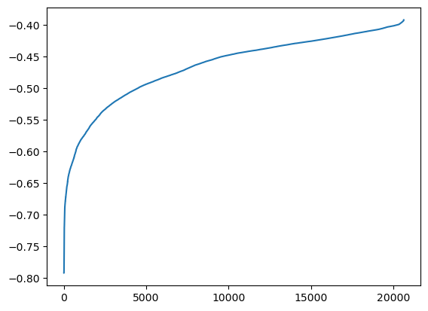
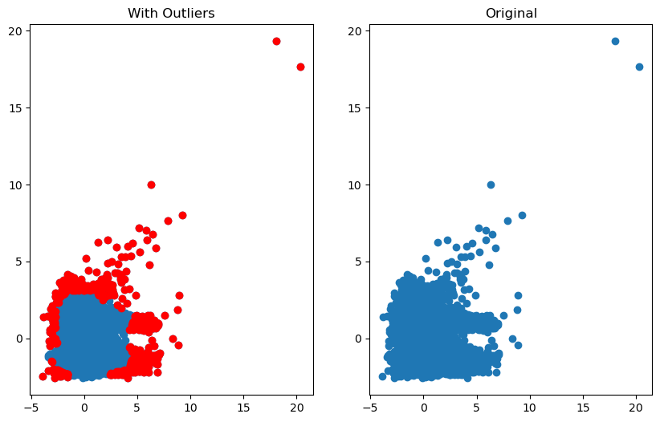
Isolation Forest : Global Outliers
In Isolation forest, I first made the graph shown below using the contamination as auto, then based on this graph later I came up with contamination = 0.03, and then made the outliers.
Graph : outliers(global)

Slide 7
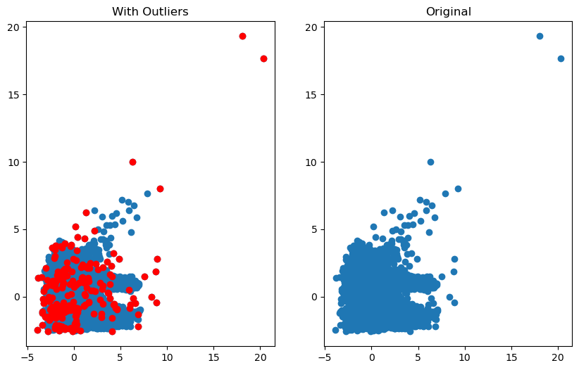
LOF : Local Outliers
For local outliers, I used LOF from sklearn.neighbors libaray, I set the value of n_neighbors = 5, algorithm = ‘auto’

Slide 8
Thanks for watching.
Made by : Utsav,
Github : utsav87589.

